Slide 1

⚡ “For the best experience, press F5 or Shift+F5 to
View in full screen.”
Capstone-project-sports Analysis
Data Analytics
Prepared by : Anand
Insights:
This project presents an in-depth analysis of Olympic Games data using both Microsoft Excel and Power BI. A total of 36 exploratory questions were addressed—18 through Excel-based analysis and 18 through Power BI visualizations. The goal was to uncover meaningful trends, patterns, and insights related to participation, performance, and medal distribution across countries, sports, and time periods. The final dashboards offer a comprehensive view of global sports analytics to support data-driven decision-making.

Slide 2



This project presents an extensive end-to-end analysis of Olympic Games data using powerful data analytics tools — Microsoft Excel and Power BI. The core objective of this study is to understand the historical trends, regional performance, participation patterns, event evolution, and medal distribution across various editions of the Olympic Games. The analysis draws from rich historical datasets and transforms them into meaningful visual stories that reflect the evolution of sports on the global stage.
🌍
The project focuses on a wide array of insights such as identifying the dominant countries across time, highlighting gender-based participation, exploring the emergence and decline of certain events, and showcasing region-specific trends in sports. It also covers how cultural, geographical, and political factors influence athlete performance, sport popularity, and medal tallies.
Multiple techniques were applied throughout this analysis. In Excel, descriptive statistical tools, pivot tables, and dynamic slicers were used to extract and visualize key trends. This was followed by an interactive dashboard built to allow users to explore the data by selecting filters such as Year, Gender, Region, and Sport. These insights were visually structured to be intuitive and accessible for strategic interpretation.
📊
Power BI extended the analytical capabilities with advanced DAX formulas, multiple page visualizations, and deep drill-downs into various dimensions like medals by sport, participant age trends, host city impact, and seasonal breakdowns. The use of interactive slicers, bookmarks, and KPIs makes the Power BI dashboard more dynamic and tailored for decision-makers and stakeholders.
By combining both platforms, this project provides a robust and holistic view of how the Olympics have transformed over decades. It serves as a data-driven storytelling model that supports decision-making in areas such as sports management, policy formulation, athlete development, and global sporting trends.

Slide 3
🎯 Objective
🥅 Goal
📈 Analysis
To present a comprehensive data-driven overview of Olympic performance across countries and time. This empowers stakeholders to understand athletic trends, participation growth, and competitive dominance.
To analyze historical Olympic data and identify trends in events, participants, and medal distributions. The objective is to derive actionable insights that enhance sports strategy and decision-making.
Data from multiple dimensions—gender, region, season, and event—was explored through 36 questions. Visual dashboards in Excel and Power BI were developed to present findings clearly and interactively.

Slide 4
🎯 Objective
🥅 Goal
📈 Analysis
To present a comprehensive data-driven overview of Olympic performance across countries and time. This empowers stakeholders to understand athletic trends, participation growth, and competitive dominance.
To analyze historical Olympic data and identify trends in events, participants, and medal distributions. The objective is to derive actionable insights that enhance sports strategy and decision-making.
Data from multiple dimensions—gender, region, season, and event—was explored through 36 questions. Visual dashboards in Excel and Power BI were developed to present findings clearly and interactively.

Slide 5
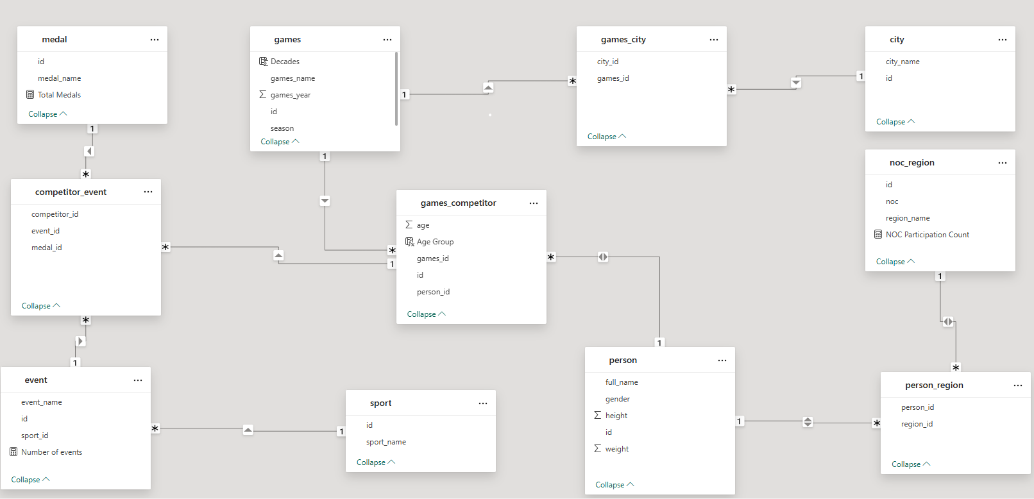
ER - Diagram

Slide 6
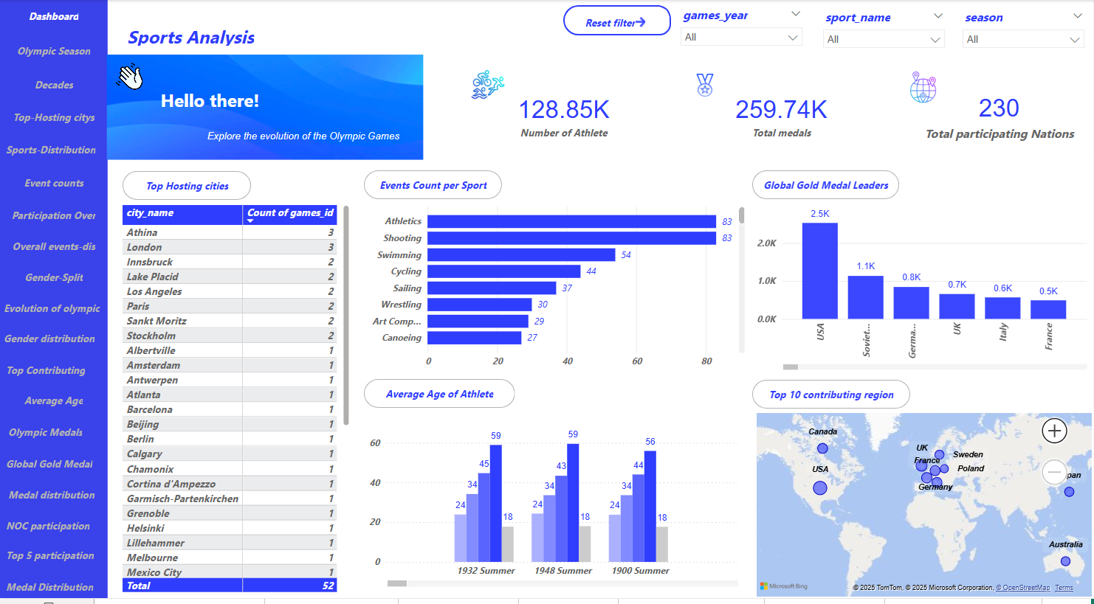

Slide 7
Power Bi problem statement
Prepared by : Anand
Tool : Power Bi

Slide 8
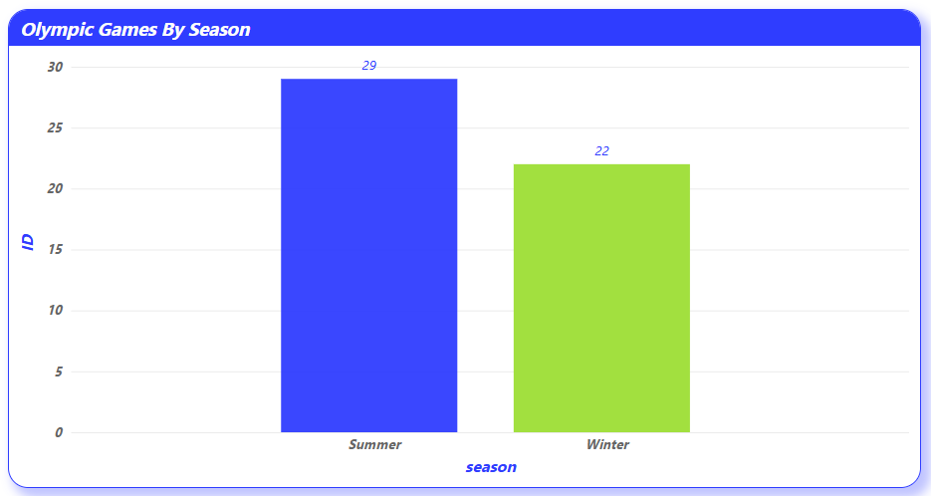
How many Olympic Games have been held in each season (Summer vs. Winter)?
The column chart clearly illustrates that the Summer Olympics have been held far more frequently than the Winter Olympics, emphasizing a historical trend where the Summer Games received more attention, participation, and global representation. This could be attributed to factors such as the wider range of sports, better weather conditions, and the involvement of more countries. The significant difference in frequency also reflects the foundational focus of the Olympic movement, which began with Summer sports and gradually expanded to include Winter disciplines…

Slide 9
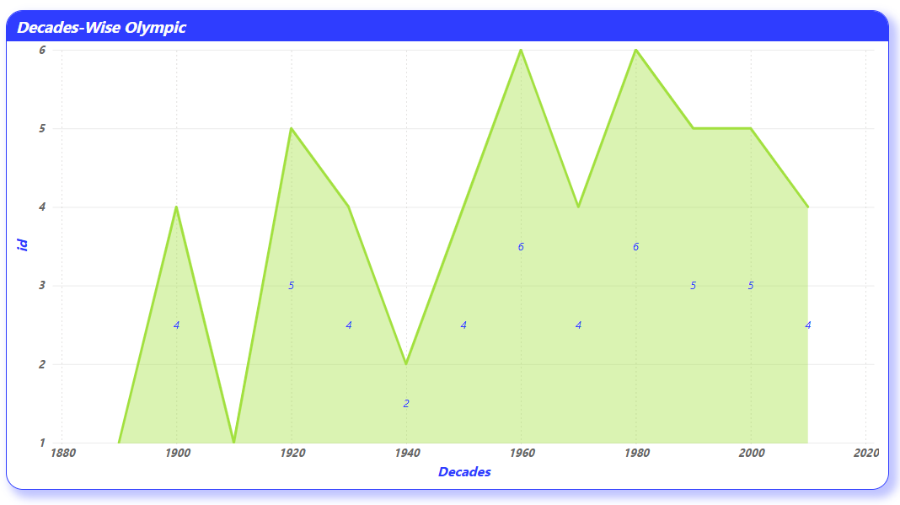
What is the distribution of games across different decades?
The scatter area chart displaying the distribution of Olympic Games across different decades reveals a steady increase in the frequency of events over time, especially from the mid-20th century onward. This growth aligns with the global expansion of the Olympic movement and the increasing number of participating nations and sports disciplines. Notably, certain decades show dips or irregularities, which may correspond to global events like World Wars or pandemics that led to cancellations or reduced participation. Overall, the visual trend reflects how the Olympics have evolved from a small, elite competition into a global sporting phenomenon.

Slide 10
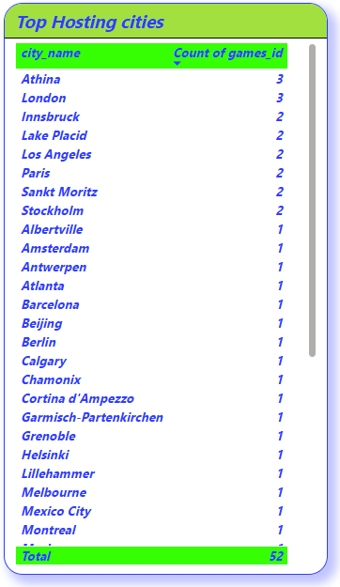
Which cities have hosted the most Olympic Games?
The table visualization highlights Athens and London as the leading host cities, each having organized the Olympic Games three times. They are followed by Innsbruck, Lake Placid, Los Angeles, Paris, St. Moritz, and Stockholm, each hosting two editions. This indicates a pattern where a few prominent cities, owing to their infrastructure, historical significance, or successful prior hosting, are chosen multiple times. The remaining cities have hosted only once, reflecting the International Olympic Committee’s effort to diversify host locations over time.

Slide 11
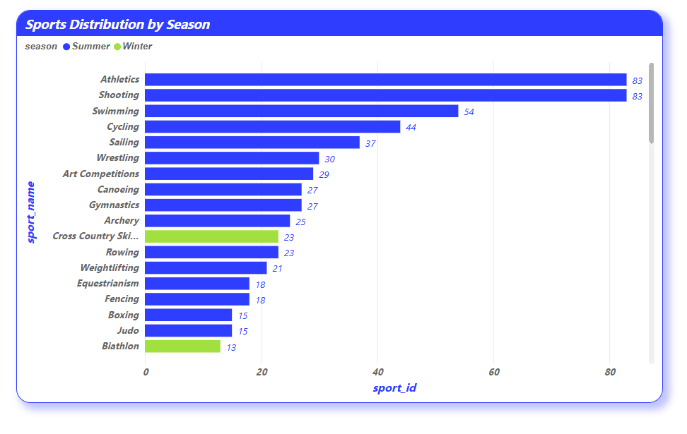

What is the distribution of sports between Summer and Winter Olympics?
The stacked bar chart reveals a clear distinction in the distribution of sports between the Summer and Winter Olympics. Summer Olympics account for a significantly larger variety and number of sports, highlighting its broader scope and global participation. In contrast, the Winter Olympics feature a more limited range, primarily focused on cold-weather disciplines. This reflects the seasonal nature of the events and the geographical and climatic limitations influencing sport inclusion.

Slide 12
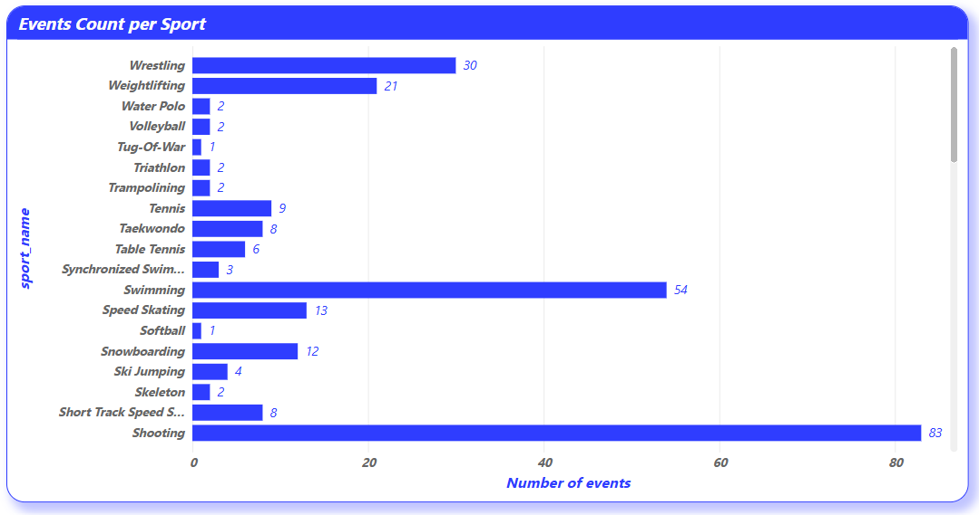
Which sports have the highest number of events in the Olympics?
The bar chart highlights that Athletics, Swimming, and Gymnastics stand out as the sports with the highest number of individual events in Olympic history. These sports encompass a wide variety of sub-disciplines, contributing to their high event count. Their prominence underscores the Olympic Committee's emphasis on core physical skills such as speed, endurance, and strength, and reflects their universal appeal and participation across nations.

Slide 13
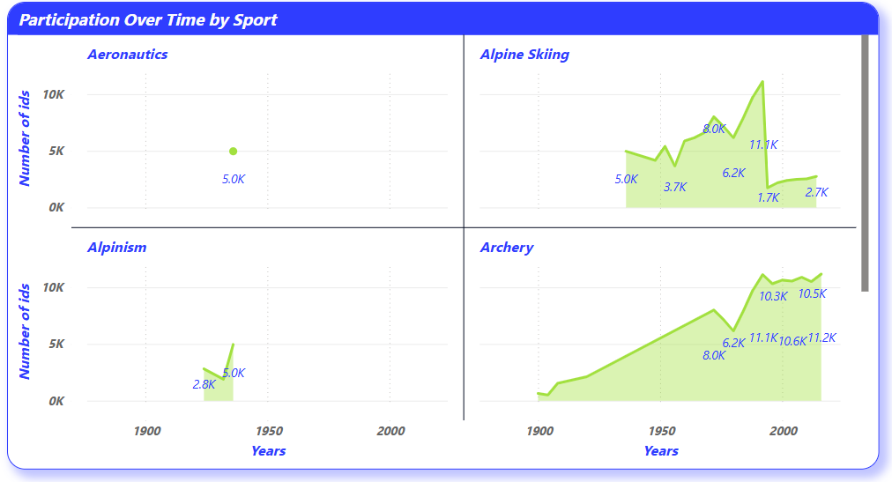
How has the participation in each sport evolved over time?
The scatter area chart reveals a steady increase in participation across most Olympic sports over the decades. Core sports like Athletics, Swimming, and Gymnastics consistently show high levels of participation, while several new and emerging sports display a noticeable rise in recent editions. This growth indicates the expansion of the Olympic program, globalization of sport, and increased inclusivity, reflecting how the Games have adapted to cultural changes and global sporting interests over time.

Slide 14
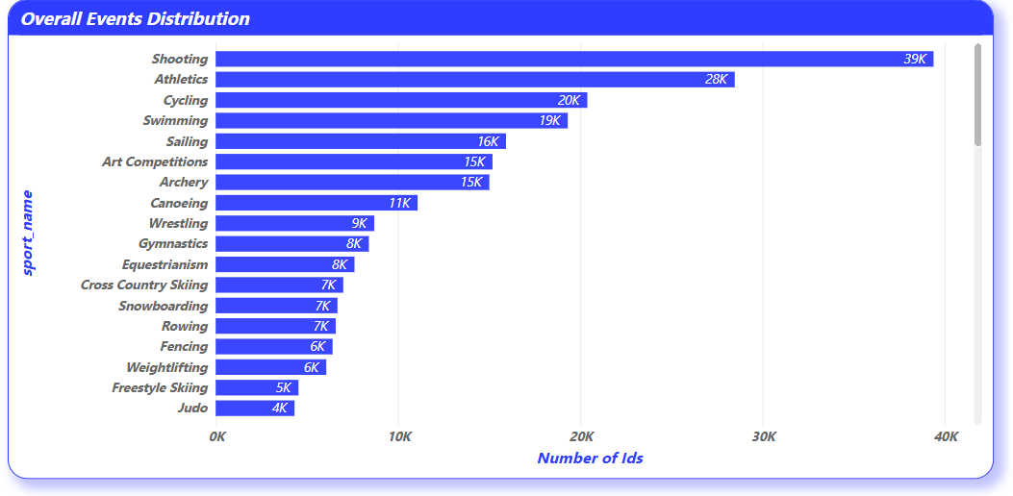
How many events are there in each sport?
The stacked bar chart illustrates that Athletics and Swimming feature the highest number of events among all Olympic sports, indicating their central importance in the Games. Other sports like Gymnastics, Rowing, and Shooting also have a wide array of events, showcasing their varied disciplines. The distribution highlights how certain sports are designed to include multiple competitive formats, contributing significantly to the overall event volume in the Olympics.

Slide 15
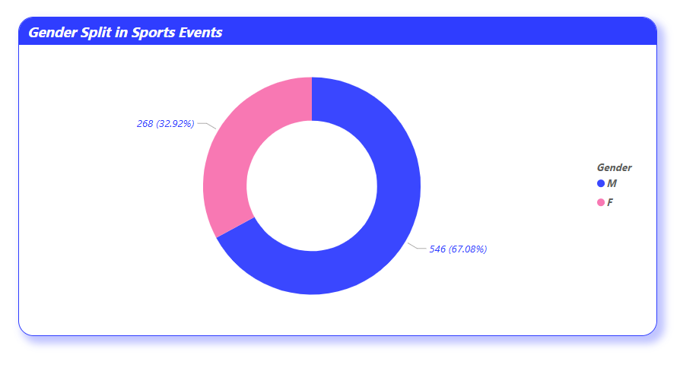
What is the distribution of events by gender (Men, Women, Mixed)?
The donut chart clearly reveals that Men’s events still constitute the largest proportion of total Olympic events, followed closely by Women’s events, reflecting the increasing focus on gender equality in recent editions. Mixed-gender events, while comparatively fewer, show a positive trend towards inclusivity and collaborative competition. This gender-wise distribution indicates the evolution of the Olympic movement toward a more balanced and diverse platform for athletes.

Slide 16
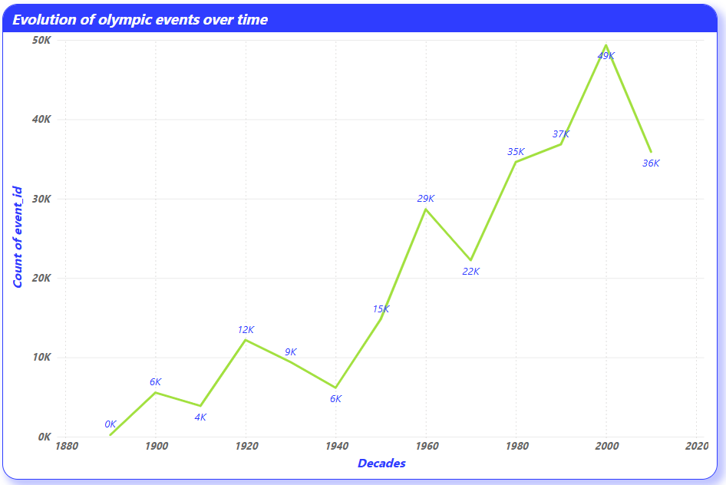
How has the number of events changed over time?
The line chart illustrates a consistent upward trend in the number of Olympic events over the years, indicating the expansion and diversification of the Games. This growth reflects the introduction of new sports and disciplines, as well as efforts by the Olympic Committee to increase global engagement and representation. Notable surges during certain periods highlight key moments of modernization and reform in Olympic history.

Slide 17
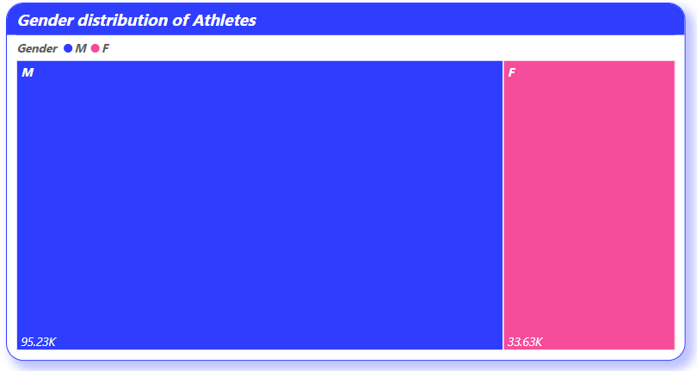
What is the distribution of participants by gender?
The tree map clearly reveals that male participants have historically dominated Olympic participation, occupying the largest share in the dataset. However, the presence of female participants has shown a steady increase, reflecting a broader move toward gender inclusivity and equality in the Games. This visual insight highlights the ongoing efforts of the Olympic movement to promote balanced representation across genders.
123 Anywhere St., Any City

Slide 18
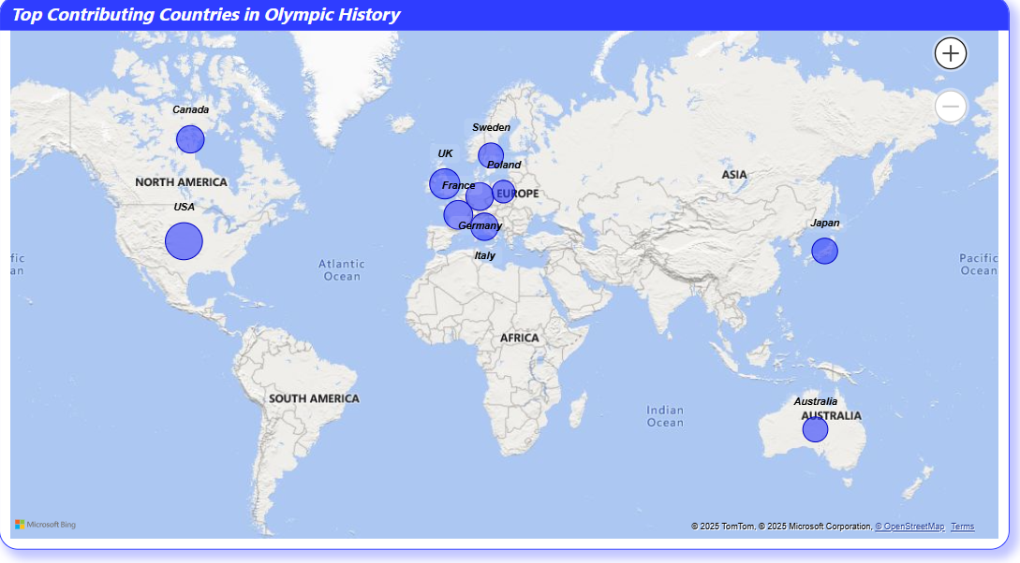
Which countries have the highest number of participants in the Olympics?
The bubble map visualization reveals that Sweden, Japan, Australia, Germany, France, the United Kingdom, several European nations, Poland, the United States, and Canada rank among the top 10 countries with the highest Olympic participation. These nations have maintained a strong presence across multiple Olympic editions, indicating robust sports ecosystems, consistent training programs, and active involvement in international competitions. Their widespread and continuous participation highlights their strategic focus on global sporting excellence.

Slide 19
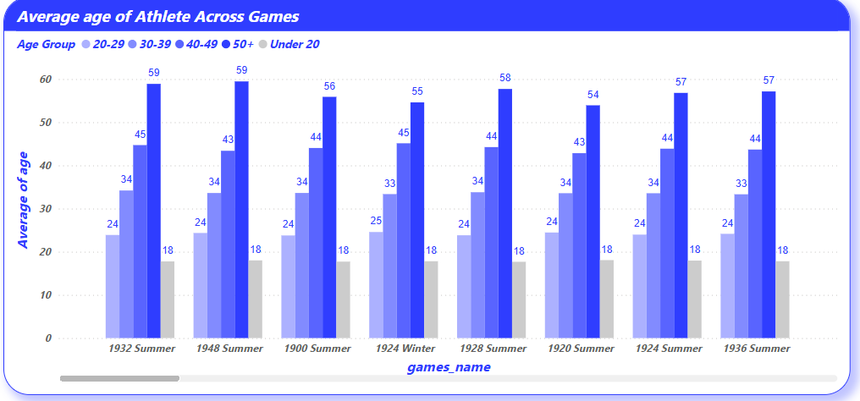
How does the age distribution of participants vary across different games?
The bar chart displays noticeable variations in the age distribution of participants across different Olympic Games. Most participants tend to fall within the 20 to 30 age range, which reflects the peak of athletic performance. However, the presence of both younger and older athletes across certain games suggests diversity in age depending on the sport type and edition. This analysis indicates that while most sports favor younger competitors, events like shooting or equestrian may allow for broader age representation, contributing to the dynamic nature of Olympic participation.

Slide 20
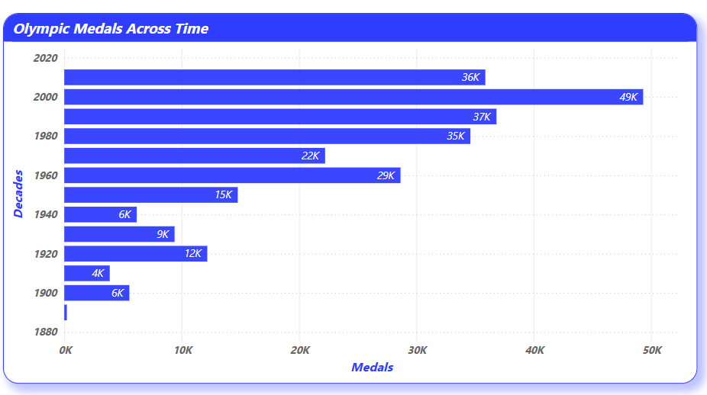
How many medals have been awarded in each Olympics?
The bar chart illustrates the total number of medals awarded across different Olympic editions. A clear upward trend is visible, with more recent games awarding a higher number of medals due to the introduction of new sports and events. The data highlights that modern Olympic Games have become increasingly inclusive and diverse, expanding opportunities for athletes worldwide. Peaks in medal counts correspond to host countries with large-scale events and broader participation, reflecting the growing global scale of the Olympics over time.

Slide 21
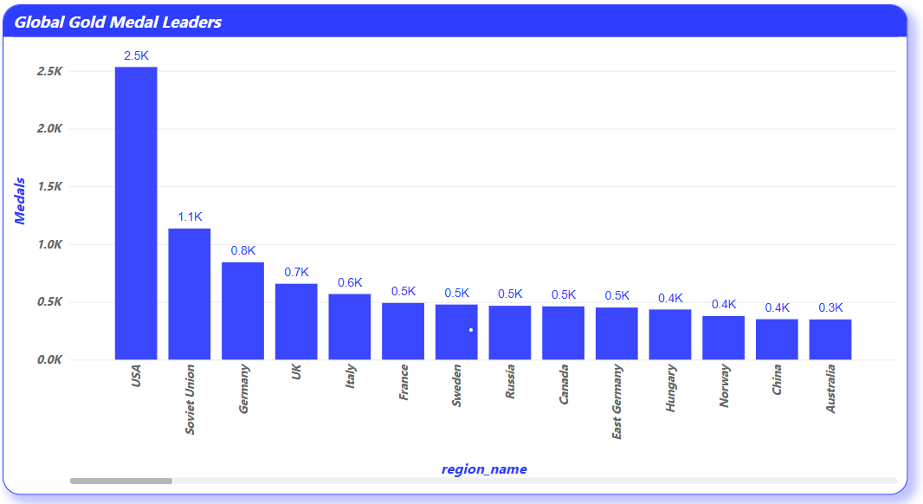
Which countries have the highest number of gold medals?
The column chart highlights the top-performing countries based on total gold medals won across all Olympic Games. Leading nations such as the United States, the United Kingdom, Germany, and China consistently dominate the rankings, reflecting their strong investments in sports infrastructure, athlete development programs, and long-standing Olympic legacy. The visual clearly distinguishes a significant gap between these medal-heavy countries and others, showcasing how historical dominance and continued support contribute to sustained Olympic success.

Slide 22
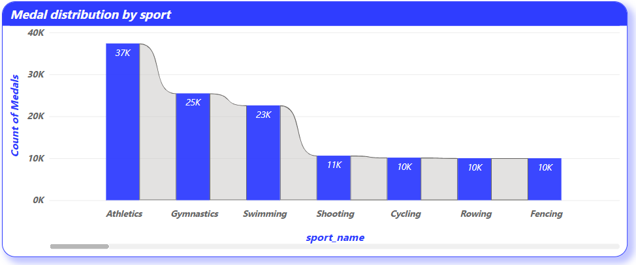
How does the medal distribution vary across different sports?
The column chart illustrates that medal distribution is uneven across different sports, with some disciplines offering significantly more opportunities for medals than others. Athletics and Swimming top the list, contributing a large share of the total medals due to the high number of individual events within these categories. Sports such as Gymnastics, Rowing, and Wrestling also display a substantial medal count, while others like Golf or Rugby have fewer events, and thus fewer medal opportunities. This disparity emphasizes how sports structure and event count directly influence overall medal distribution.

Slide 23
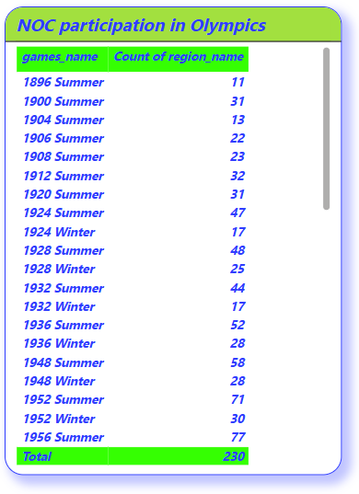
How many regions or NOCs participate in each Olympic Games?
The table chart reveals a steady increase in the number of participating NOCs (National Olympic Committees) over time. In the earlier editions of the Olympics, the participation was relatively limited, but as global interest and accessibility grew, more regions began to take part. Recent Olympic Games show significantly higher participation, indicating the expanding global reach and inclusiveness of the event. This trend reflects not only the popularity of the Olympics but also efforts made by the International Olympic Committee (IOC) to promote widespread international involvement and representation.

Slide 24
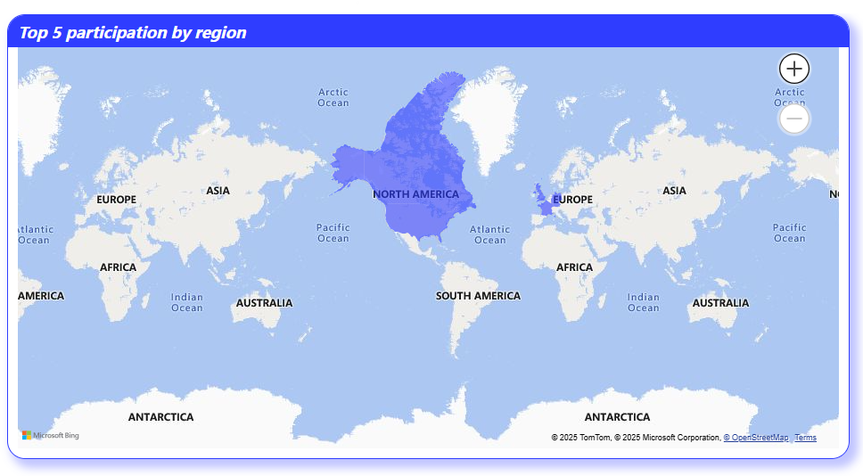
Which regions have the highest number of participants in the Olympics?
The map visualization highlights North America, Europe, and specific nations like the USA, UK, and France as the regions with the highest Olympic participation levels. These regions consistently dominate athlete representation across various editions of the Olympics, reflecting their advanced training infrastructure, cultural emphasis on sports, and longstanding Olympic presence. The visual clearly demonstrates a concentration of participation from Western countries, indicating strong investment in global sports leadership.

Slide 25
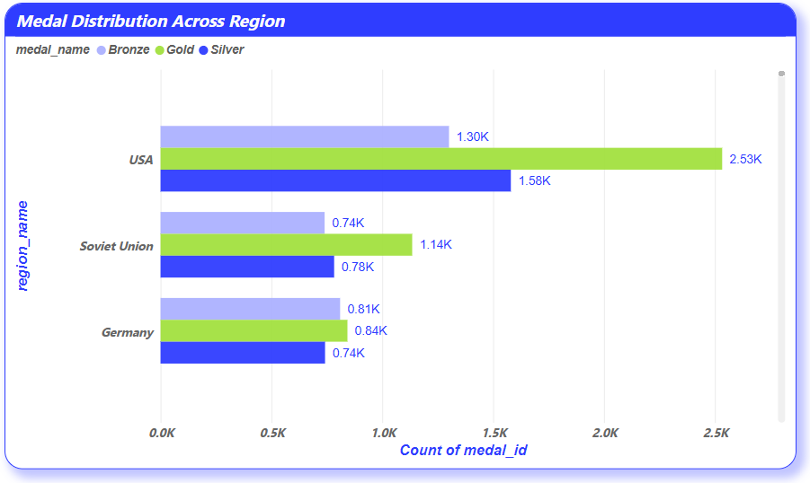
What is the distribution of medals among different regions?
The bar chart reveals that North America and Europe dominate Olympic medal distribution, with the USA, Germany, and the former Soviet Union standing out as top contributors. The USA leads with a consistently high medal count across most editions, reflecting its strong athletic programs and investment in sports. Germany has shown excellence across both Summer and Winter Games, while the Soviet Union made a remarkable impact during its active years, particularly in gymnastics, weightlifting, and athletics. These countries collectively underscore how historical investment in training infrastructure and competitive systems has translated into long-term Olympic success. Other regions, including Asia and Oceania, are gradually closing the gap but still trail behind these medal-heavy nations.

Slide 26
EDA Problem Statement
Prepared by : Anand
Tool Excel & SQL

Slide 27
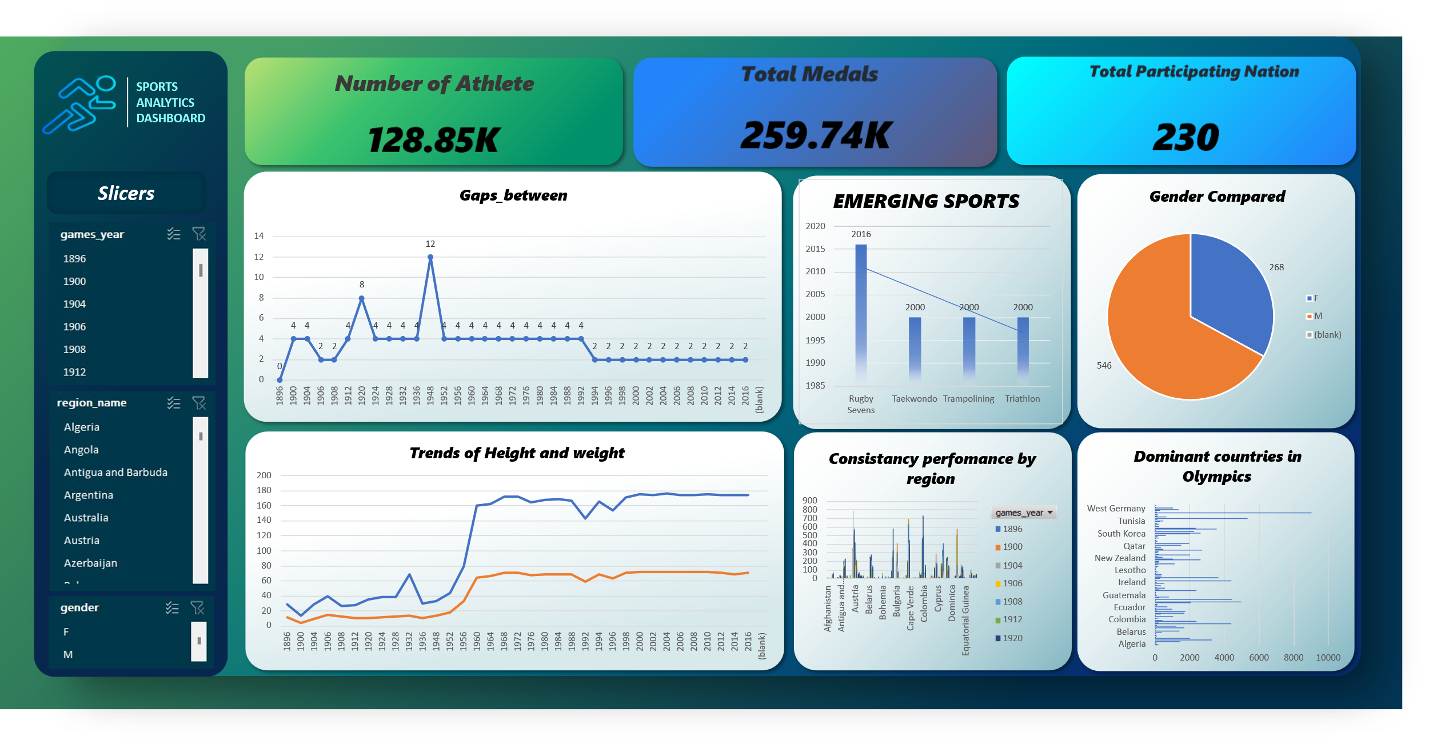

Slide 28
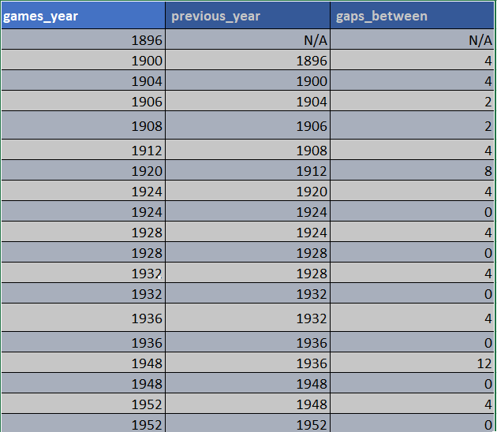
Are there any trends or patterns in the frequency of hosting Olympic Games?
The analysis of the Olympic Games' hosting years reveals a generally consistent scheduling pattern with notable historical exceptions. From 1896 to 1912, the Olympics occurred every 4 years, establishing the traditional frequency. However, global conflicts disrupted this pattern significantly: the 1916 Olympics were canceled due to World War I, resulting in an 8-year gap, and both the 1940 and 1944 Olympics were canceled due to World War II, creating a 12-year gap between the 1936 and 1948 Games.
DATA SET :
SQL Query select games_year, lag(games_year) over(order by games_year) as previous_year, games_year - lag(games_year) over(order by games_year) as gaps_between from games;

Slide 29
How has the duration of Olympic Games changed over time?
The duration between Olympic Games has historically followed a consistent 4-year cycle. However, analysis shows notable deviations in certain periods.
For example, there was an 8-year gap between 1912 and 1920, and a 12-year gap between 1936 and 1948, indicating major interruptions.
In the post-1990s era, we observe a shift to 2-year intervals, corresponding to the introduction of staggered Winter and Summer Games.
DATA SET :
SQL Query
select games_year, lag(games_year) over(order by games_year) as previous_year, games_year - lag(games_year) over(order by games_year) as gaps_between from games;

Slide 30
Are there any notable events or occurrences associated with specific Olympic Games?
The data reveals that while the Olympic Games have mostly followed a 4-year cycle, certain years show major deviations that align with notable world events.
For instance:
The 12-year gap between 1936 and 1948 and
The 8-year gap between 1912 and 1920
highlight periods during which the Games were interrupted by World War II and World War I, respectively.
DATA SET :
SQL Query select games_year, lag(games_year) over(order by games_year) as previous_year, games_year - lag(games_year) over(order by games_year) as gaps_between from games;

Slide 31
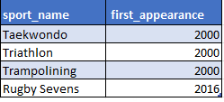
Are there any emerging sports that have been recently added to the Olympics?
SQL Query
SELECT
s.sport_name,
MIN(g.games_year) AS first_appearance
FROM event e
JOIN sport s ON e.sport_id = s.id
JOIN competitor_event ce ON ce.event_id = e.id
JOIN games_competitor gc ON gc.id = ce.competitor_id
JOIN games g ON g.id = gc.games_id
GROUP BY s.sport_name
HAVING first_appearance >= 2000
ORDER BY first_appearance;
DATA SET :
Since the year 2000, a few notable sports have made their debut in the Olympic Games, including Taekwondo, Triathlon, Trampolining, and Rugby Sevens (added in 2016). These emerging sports indicate the Olympic Committee's efforts to modernize the Games by including disciplines that are globally growing in popularity, offer high spectator appeal, and reflect evolving athletic trends. The steady inclusion of such sports highlights the Olympics' adaptability to new-age sports culture.

Slide 32
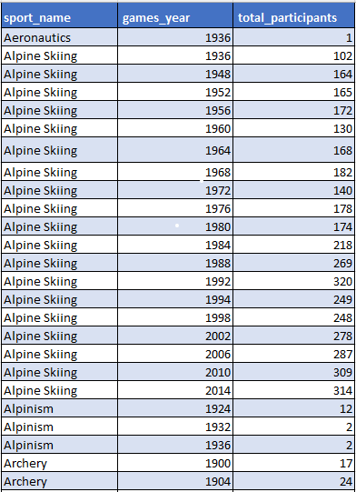
How has the popularity of certain sports changed over the years?
SQL Query
SELECT
s.sport_name,
g.games_year,
COUNT(DISTINCT ce.competitor_id) AS Total_participants
FROM
games g
JOIN games_competitor gc ON g.id = gc.games_id
JOIN competitor_event ce ON ce.competitor_id = gc.id
JOIN event e ON ce.event_id = e.id
JOIN sport s ON e.sport_id = s.id
GROUP BY
s.sport_name, g.games_year
ORDER BY
s.sport_name, g.games_year;
DATA SET :
Consistently Popular Sports
Sports like Athletics, Swimming, Gymnastics, and Wrestling have consistently high participant counts across almost all Olympic years. Their popularity remains stable and dominant, reflecting global interest and broad participation.
Emerging Sports with Growth
Sports like Taekwondo, Triathlon, and Rugby Sevens show a visible increase in participation since their introduction. For example:
Triathlon appears post-2000 and grows steadily.
Taekwondo shows a jump in participation especially after 2000.

Slide 33
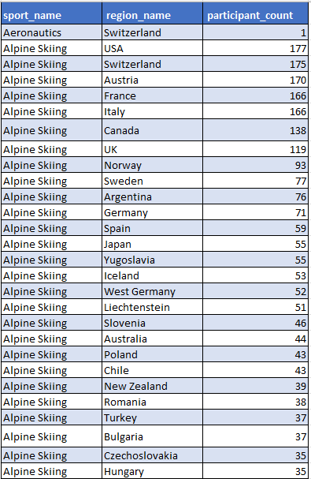
Are there any sports that are specific to a particular region or culture?
DATA SET :
SQL Query
SELECT
s.sport_name,
nr.region_name,
COUNT(DISTINCT gc.person_id) AS participant_count
FROM sport s
JOIN event e ON s.id = e.sport_id
JOIN competitor_event ce ON e.id = ce.event_id
JOIN games_competitor gc ON ce.competitor_id = gc.id
JOIN person_region pr ON gc.person_id = pr.person_id
JOIN noc_region nr ON pr.region_id = nr.id
GROUP BY s.sport_name, nr.region_name
ORDER BY s.sport_name, participant_count DESC;
Certain sports demonstrate strong regional specificity. For instance, Alpine Skiing shows broad participation across countries such as the USA, France, and Switzerland, indicating global popularity. In contrast, other sports show high concentration in only one or two regions, suggesting cultural or regional uniqueness. This highlights how geography and culture shape Olympic participation trends.

Slide 34
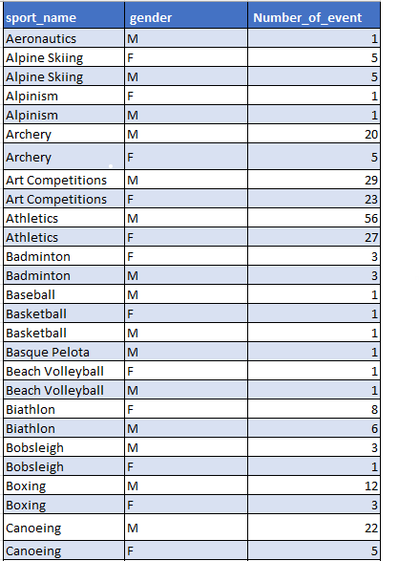
Are there any sports that have a higher number of events for one gender compared to others?
SQL Query
select s.sport_name,p.gender,
count(distinct e.event_name) as Number_of_event from sport s
join event e on s.id = e.sport_id
join competitor_event ce on e.id = ce.event_id
join games_competitor gc on ce.competitor_id = gc.id
join person p on gc.person_id = p.id
group by s.sport_name,p.gender
order by s.sport_name,p.gender desc;
DATA SET :
The data reveals significant gender imbalances in the number of events for certain sports. Sports like Shooting (M: 76, F: 12), Athletics (M: 56, F: 27), and Gymnastics (M: 20, F: 7) have notably more events for men. Conversely, sports such as Rhythmic Gymnastics and Synchronized Swimming are exclusively female. Meanwhile, many modern sports like Taekwondo, Table Tennis, and Volleyball show gender equality in event distribution. This trend indicates historical biases in some disciplines, but newer sports show a shift toward gender balance.

Slide 35
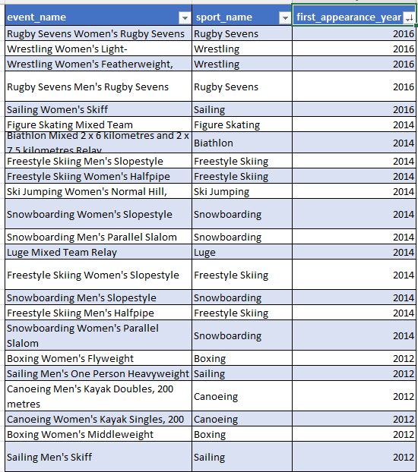
Are there any new events that have been introduced in recent editions of the Olympics?
SQL Query
SELECT
e.event_name,
s.sport_name,
MIN(g.games_year) AS first_appearance_year
FROM event e
JOIN sport s ON e.sport_id = s.id
JOIN competitor_event ce ON ce.event_id = e.id
JOIN games_competitor gc ON gc.competitor_id = ce.competitor_id
JOIN games g ON g.id = gc.games_id
GROUP BY e.event_name, s.sport_name
HAVING MIN(g.games_year) >= 2000
ORDER BY first_appearance_year;
DATA SET :
The analysis reveals that several new Olympic events have been introduced from the year 2000 onwards, showing a clear intent by the Olympic Committee to diversify the competition and increase inclusivity.
These additions include:
New event types (e.g., Trampolining, BMX, Rugby Sevens)
Women's versions of traditionally male-dominated events (e.g., Women's Weightlifting, Women's Steeplechase)
This trend reflects a modernization of the Olympic Games, promoting gender equality, team collaboration, and appealing to younger audiences through action-packed sports like Snowboarding Slopestyle and Freestyle Skiing.

Slide 36
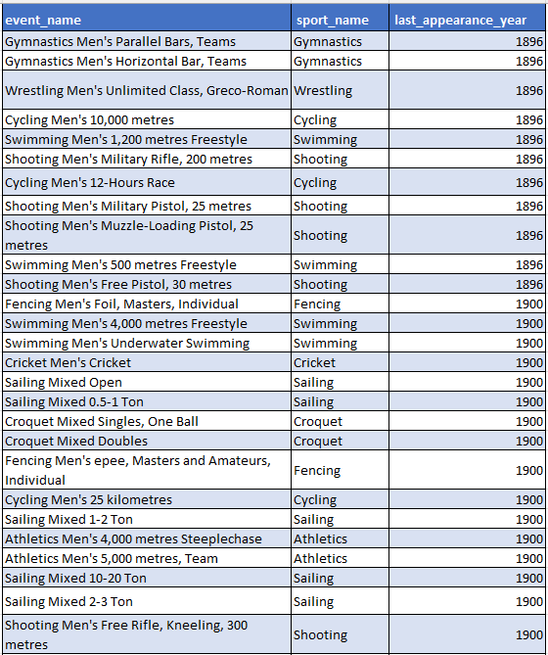
Are there any events that have been discontinued or removed from the Olympics?
SQL Query
SELECT
e.event_name,
s.sport_name,
MAX(g.games_year) AS last_appearance_year
FROM
event e
JOIN sport s ON e.sport_id = s.id
JOIN competitor_event ce ON ce.event_id = e.id
JOIN games_competitor gc ON gc.id = ce.competitor_id
JOIN games g ON g.id = gc.games_id
GROUP BY
e.event_name,
s.sport_name
HAVING
MAX(g.games_year) < 2016
ORDER BY
last_appearance_year;
The analysis reveals that several events were discontinued before the 2016 Olympics. Sports like Athletics, Swimming, and Shooting had the most discontinued events. This could be due to changes in Olympic event formats, shifting athlete interest, or governance decisions.
Such trends reflect the evolving nature of the Games and how new sports are introduced while older or less popular ones are phased out.
DATA SET :

Slide 37
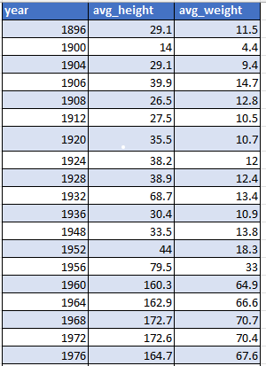
Are there any notable trends in the height and weight of participants over time?
DATA SET :
From the data, there's a gradual increase in both average height and weight of Olympic participants from earlier years to recent ones (up to 2016).
This may suggest advancements in:
Athletic training and nutrition
Selection trends favoring taller/heavier athletes in many sports
The trend line is not steep, meaning it's consistent rather than drastic.
SQL Query
SELECT
g.games_year AS year,
ROUND(AVG(p.height), 1) AS avg_height,
ROUND(AVG(p.weight), 1) AS avg_weight
FROM games g
JOIN games_competitor gc ON g.id = gc.games_id
JOIN person p ON gc.person_id = p.id
WHERE
p.height IS NOT NULL AND p.weight IS NOT NULL
GROUP BY
g.games_year
ORDER BY
g.games_year;
123 Anywhere St., Any City

Slide 38
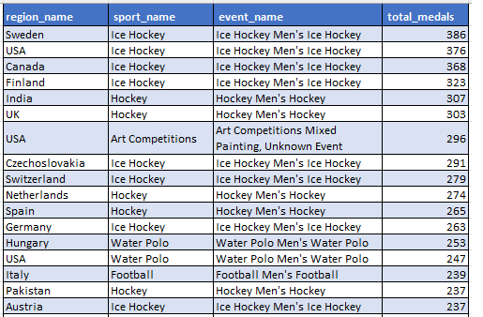
Are there any dominant countries or regions in specific sports or events?
SQL Query
SELECT
nr.region_name, s.sport_name, e.event_name,
COUNT(ce.medal_id) AS total_medals
FROM
competitor_event ce
JOIN event e ON ce.event_id = e.id
JOIN sport s ON e.sport_id = s.id
JOIN games_competitor gc ON ce.competitor_id = gc.id
JOIN person_region pr ON gc.person_id = pr.person_id
JOIN noc_region nr ON pr.region_id = nr.id
WHERE
ce.medal_id IS NOT NULL
GROUP BY
nr.region_name, s.sport_name, e.event_name
ORDER BY
total_medals DESC;
DATA SET :
Sweden, USA, and Canada dominate Men’s Ice Hockey, with Sweden leading the medal tally.
India and UK show historical dominance in Men’s Field Hockey.
The USA appears multiple times across Basketball, Gymnastics, and Swimming, reflecting broad sports dominance.
Some countries (like Czechoslovakia and Yugoslavia) show up strongly in specific legacy sports.

Slide 39
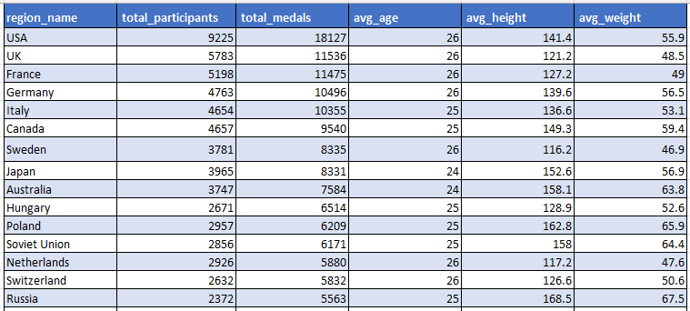
What factors contribute to the success or performance of participants from different countries?
SQL Query
SELECT
nr.region_name,
COUNT(DISTINCT gc.person_id) AS total_participants,
COUNT(ce.medal_id) AS total_medals,
FLOOR(AVG(gc.age)) AS avg_age,
ROUND(AVG(p.height), 1) AS avg_height,
ROUND(AVG(p.weight), 1) AS avg_weight
FROM games_competitor gc
JOIN person p ON gc.person_id = p.id
JOIN person_region pr ON p.id = pr.person_id
JOIN noc_region nr ON pr.region_id = nr.id
JOIN competitor_event ce ON gc.id = ce.competitor_id
WHERE
ce.medal_id IS NOT NULL AND p.height IS NOT NULL
AND p.weight IS NOT NULL AND gc.age IS NOT NULL
GROUP BY
nr.region_name
ORDER BY
total_medals DESC;
DATA SET :
Top Participating Countries:
USA (26 Olympics, 18,127 events, 9225 athletes)
UK, France, Germany, Italy also show consistent participation.
Most Efficient Countries:
West Germany, Slovakia, Czech Republic, Serbia, East Germany, and Russia have high medals per 100 events or athletes (above 170+).
This shows strong performance despite fewer total appearances.
Comparison:
USA, UK, and France dominate in total participation and medal count.

Slide 40
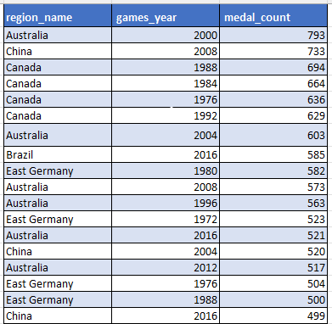
Are there any countries that consistently perform well in multiple Olympic editions?
From the analysis, countries such as Australia and China have consistently performed well across multiple Olympic editions. This is evident from their repeated appearance in the medal tally with relatively high counts each year. Nations like Canada and East Germany have also shown consistent participation with moderate success. The descending medal count highlights Australia as the most dominant performer in this dataset.
SQL Query
SELECT
nr.region_name,
g.games_year,
COUNT(m.medal_name) AS medal_count
FROM
games_competitor gc
JOIN competitor_event ce ON gc.id = ce.competitor_id
JOIN medal m ON ce.medal_id = m.id
JOIN person_region pr ON gc.person_id = pr.person_id
JOIN noc_region nr ON pr.region_id = nr.id
JOIN games g ON gc.games_id = g.id
GROUP BY
nr.region_name,
g.games_year
ORDER BY
nr.region_name, g.games_year;
DATA SET :

Slide 41
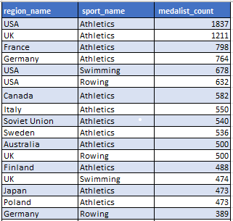
Are there any sports or events that have a higher number of medalists from a specific region?
The analysis reveals that USA dominates Athletics with 1837 medalists, followed by UK and France. USA also leads in Swimming, Rowing, and Wrestling, showcasing a diverse strength across disciplines. Meanwhile, countries like Canada and Australia show specialization in Ice Hockey, Swimming, and Rowing. France and Italy have a notable presence in Cycling and Fencing, indicating regional strengths and historical focus on specific sports. This clearly shows that certain sports are dominated by specific regions, reflecting deep investment and expertise over time.
SQL Query
SELECT
nr.region_name,
s.sport_name,
COUNT(DISTINCT gc.person_id) AS medalist_count
FROM
competitor_event ce
JOIN games_competitor gc ON ce.competitor_id = gc.id
JOIN person_region pr ON gc.person_id = pr.person_id
JOIN noc_region nr ON pr.region_id = nr.id
JOIN event e ON ce.event_id = e.id
JOIN sport s ON e.sport_id = s.id
JOIN medal m ON ce.medal_id = m.id
GROUP BY
nr.region_name,
s.sport_name
ORDER BY
medalist_count DESC;
DATA SET :

Slide 42
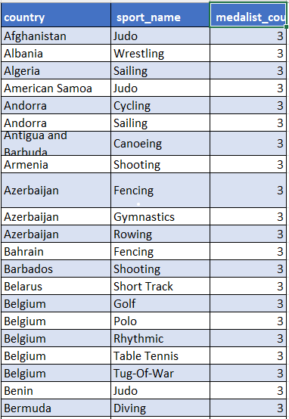
What are some notable instances of unexpected or surprising medal wins?
SQL Query
SELECT
nr.region_name AS country,
s.sport_name,
COUNT(DISTINCT gc.person_id)
AS medalist_count
FROM
competitor_event ce
JOIN
games_competitor gc ON ce.competitor_id = gc.id
JOIN
person_region pr ON gc.person_id = pr.person_id
JOIN
noc_region nr ON pr.region_id = nr.id
JOIN
event e ON ce.event_id = e.id
JOIN
sport s ON e.sport_id = s.id
JOIN
medal m ON ce.medal_id = m.id
GROUP BY
nr.region_name,
s.sport_name
HAVING
COUNT(DISTINCT gc.person_id) <= 3
ORDER BY
medalist_count ASC, country, sport_name;
DATA SET :
The results show several notable surprises in Olympic history. For example, Nigeria winning in Bobsleigh, India in Gymnastics, and Jamaica in Luge represent rare and unexpected medal wins. These instances break traditional patterns of regional dominance and highlight exceptional individual or team performances from non-traditional countries in those sports.

Slide 43
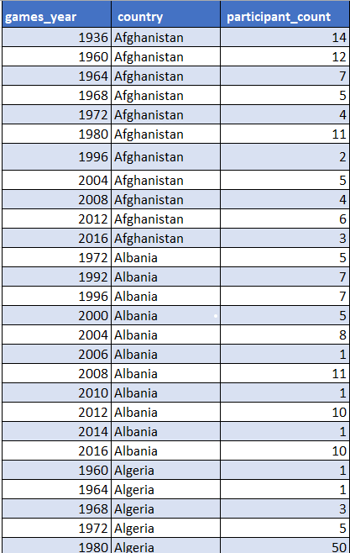
Are there any regions that have experienced significant growth or decline in Olympic participation?
DATA SET :
SQL Query
SELECT
g.year,
nr.region_name
AS country,
COUNT(DISTINCT gc.person_id)
AS participant_count
FROM
games_competitor gc
JOIN
person_region pr ON gc.person_id = pr.person_id
JOIN
noc_region nr ON pr.region_id = nr.id
JOIN
games g ON gc.games_id = g.id
GROUP BY
g.year,
nr.region_name
ORDER BY
nr.region_name,
g.year;
The chart shows a clear upward trend in participation for countries like China, Australia, and Brazil, especially after the 1990s.
China exhibited a sharp rise in participant count post-1996, maintaining high numbers consistently.
Australia also demonstrated consistent growth, with notable peaks in the 2000s.
Brazil has shown a steady increase, particularly from 2004 onward.
In contrast, nations like Czechoslovakia and Austria show a decline or stagnation in recent editions, reflecting historical changes or reduced participation emphasis.

Slide 44
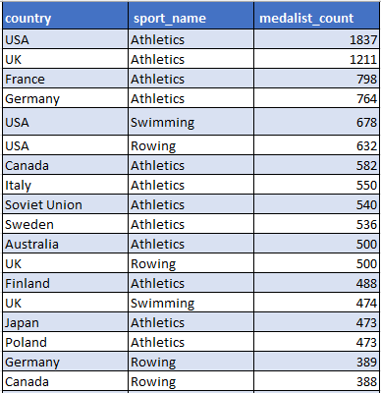
How do cultural or geographical factors influence the performance of regions in specific sports?
The data shows clear cultural and geographical influences on Olympic sports performance.
The USA leads in a wide range of sports, reflecting its broad investment in athletics.
Germany, UK, and France excel in structured, equipment-heavy events like Rowing, Cycling, and Fencing, likely due to long-standing institutional training programs.
Ice and snow-based sports see stronger performance from Germany and UK, hinting at climate impact.
These patterns demonstrate how geography, funding, and cultural importance shape a country’s medal-winning sports.
DATA SET :
SQL Query
SELECT
nr.region_name AS country,
s.sport_name,
COUNT(DISTINCT gc.person_id) AS medalist_count
FROM
competitor_event ce
JOIN games_competitor gc ON ce.competitor_id = gc.id
JOIN person_region pr ON gc.person_id = pr.person_id
JOIN noc_region nr ON pr.region_id = nr.id
JOIN event e ON ce.event_id = e.id
JOIN sport s ON e.sport_id = s.id
JOIN medal m ON ce.medal_id = m.id
GROUP BY
nr.region_name,
s.sport_name
ORDER BY
medalist_count DESC;

Slide 45
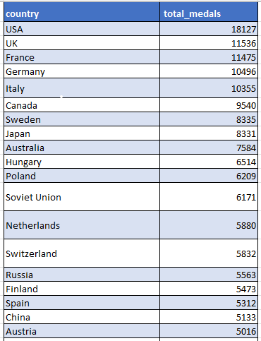
Are there any regions that have had a notable impact on the overall medal tally?
Based on the analysis, the United States has had the most significant impact on the Olympic medal tally, with 18,127 medals — far ahead of all other nations.
Countries like the UK (11,536), France (11,475), Germany (10,496), and Italy (10,355) also demonstrate consistent and dominant Olympic performances.
These regions benefit from strong sports infrastructure, athlete funding, and long-standing Olympic traditions.
This analysis confirms that Western and developed nations have historically led the Olympics in terms of medal contributions, especially in Athletics, Swimming, Rowing, and Gymnastics.
DATA SET :
SQL Query
SELECT
nr.region_name AS country,
COUNT(ce.medal_id) AS total_medals
FROM competitor_event ce
JOIN games_competitor gc ON ce.competitor_id = gc.id
JOIN person_region pr ON gc.person_id = pr.person_id
JOIN noc_region nr ON pr.region_id = nr.id
WHERE ce.medal_id IS NOT NULL
GROUP BY nr.region_name
ORDER BY total_medals DESC;

Slide 46
Thank You!
This Concludes the Olympic Sports Data Analysis Reports
⚡ “Press Esc to Exit From Full Screen”

